Slide 1
React Lifecycle & Synthetic Event
by Kulinskyi Vitalii

Slide 2
AGENDA
Lifecycle
Lifecycle of Components
Mounting
Updating
Unmounting
SyntheticEvent
React Events
Events Handler
Supported Events

Slide 3
Lifecycle of Components
Each component in React has a lifecycle which you can monitor and manipulate during its three main phases:
Mounting
Update
Unmounting

Slide 4
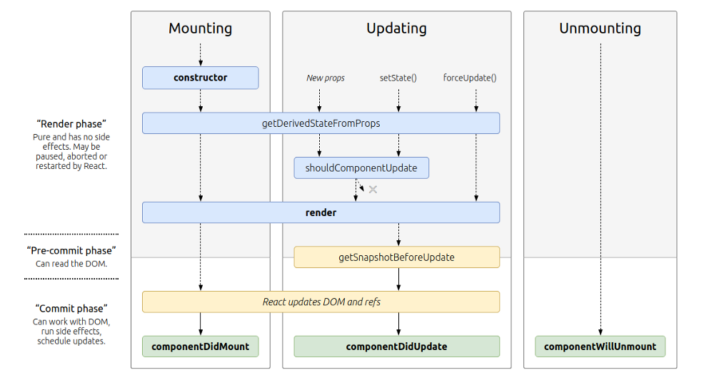
Lifecycle of Components

Slide 5
Mounting
After preparing with basic needs, state and props, our React Component is ready to mount in the browser DOM.
This phase gives hook methods for before and after mounting of components.
React has four built-in methods that gets called, in this order, when mounting a component:
constructor( )
getDerivedStateFromProps( )
render( )
componentDidMount( )
The render( ) method is required and will always be called, the others are optional and will be called if you define them.

Slide 6
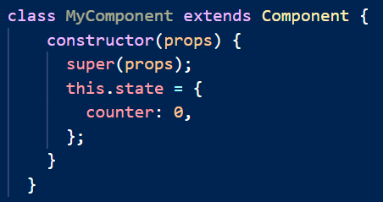
constructor( )
Called before anything else, when the component is initiated, and it is the natural place to set up the initial state and other initial values.
Called with the props, as arguments, and you should always start by calling the super(props) before anything else

Slide 7
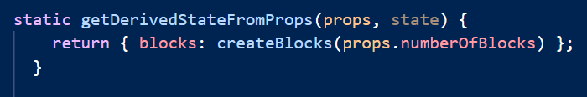
getDerivedStateFromProps( )
Called right before rendering the element(s) in the DOM.
This is the natural place to set the state object based on the initial props.
It takes state as an argument, and returns an object with changes to the state.

Slide 8
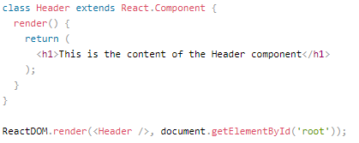
render( )
The render() method is required, and is the method that actually outputs the HTML to the DOM.

Slide 9
componentDidMount( )
This is the hook method which is executed after the component did mount on the DOM.
This method is executed once in a lifecycle of a component and after the first render.
As, in this method, we can access the DOM
Usage: this is the right method to integrate API

Slide 10
Updating
A component is updated whenever there is a change in the component's state or props.
React has five built-in methods that gets called, in this order, when a component is updated:
getDerivedStateFromProps()
shouldComponentUpdate()
render()
getSnapshotBeforeUpdate()
componentDidUpdate()
The render() method is required and will always be called, the others are optional and will be called if you define them.

Slide 11
Updating
getDerivedStateFromProps( ) - first method that is called when a component gets updated
render( ) - called when a component gets updated, it has to re-render the HTML to the DOM, with the new changes.

Slide 12
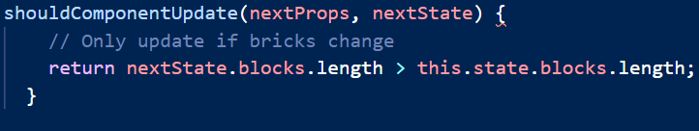
shouldComponentUpdate()
This method tells the React that when the component receives new props or state is being updated, should React re-render or it can skip rendering?
Method you can return a Boolean value that specifies whether React should continue with the rendering or not.
The default value is true.

Slide 13
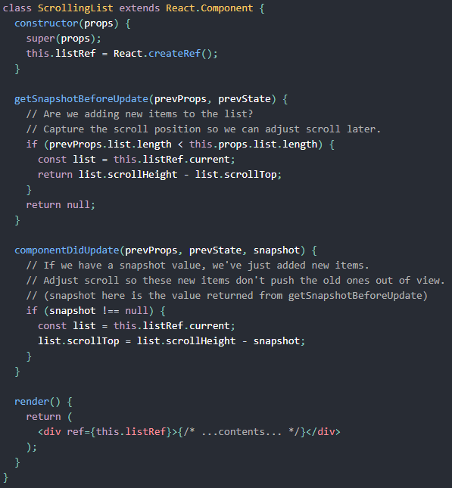
getSnapshotBeforeUpdate()
In the method you have access to the props and state before the update, meaning that even after the update, you can check what the values were before the update.
If the method is present, you should also include the componentDidUpdate() method, otherwise you will get an error.

Slide 14
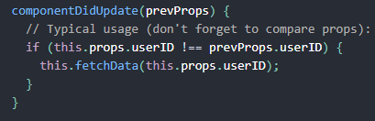
componentDidUpdate()
Method is called after the component is updated in the DOM
Method is not called for the initial render.

Slide 15
Unmounting
In this phase, the component is not needed and the component will get unmounted from the DOM.
The method which is called in this phase :
componentWillUnmount()

Slide 16
componentWillUnmount( )
This method is the last method in the lifecycle.
This is executed just before the component gets removed from the DOM.
Usage: In this method, we do all the cleanups related to the component.
For example, on logout, the user details and all the auth tokens can be cleared before unmounting the main component.

Slide 17
SyntheticEvent

Slide 18
React Events
An event is an action that could be triggered as a result of the user action or system generated event.
For example, a mouse click, loading of a web page, pressing a key, window resizes, and other interactions are called events.
React has its own event handling system which is very similar to handling events on DOM elements.
The react event handling system is known as Synthetic Events.
The synthetic event is a cross-browser wrapper of the browser's native event.

Slide 19
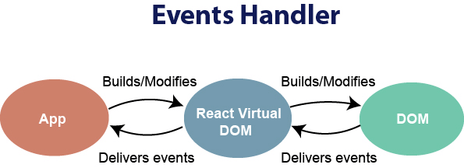
Events Handler

Slide 20
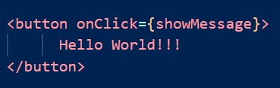
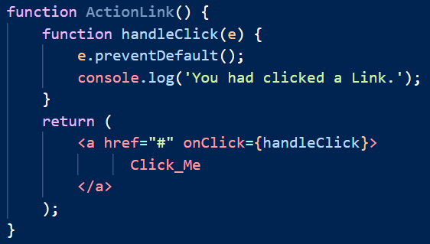
Events Handler
Handling events with react have some syntactic differences from handling events on DOM. These are:
React events are named as camelCase instead of lowercase.
With JSX, a function is passed as the event handler instead of a string.
In react, we cannot return false to prevent the default behavior. We must call preventDefault event explicitly to prevent the default behavior.

Slide 21
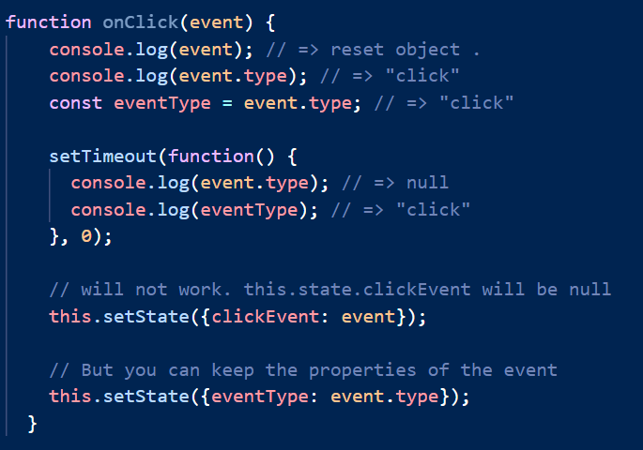
Synthetic Events
SyntheticEvent is pooled. This means that the SyntheticEvent object will be reused and all properties will be invalidated after the callback event handler is executed. This is done for performance reasons. Thus, you cannot access the event in an asynchronous way.

Slide 22
Supported Events
Clipboard Events
Composition Events
Keyboard Events
Focus Events
Form Events
UI Events
Generic Events
Mouse Events
Pointer Events
Selection Events
Touch Events
Wheel Events
Media Events
Image Events
Animation Events
Transition Events
Other Events
For more details visit: SyntheticEvent

Slide 23


